Slide 1
CIFAR-10 Image Classification using CNN
Course: CSC3218 Deep Learning Name: Wangolo Bachawa Reg No: M23B23/042 Date: April 2026

Slide 2
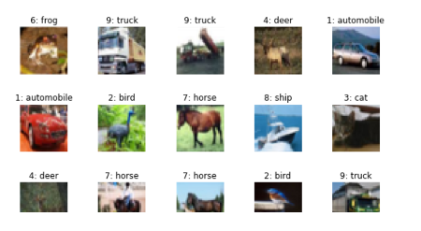
Problem Statement
Problem: Image Classification Goal: Automatically classify images into 10 categories Example classes: airplane, car, bird, cat, deer, dog, frog, horse, ship, truck Challenge: Images are small (32×32) and complex

Slide 3
Dataset
Dataset: CIFAR-10
60,000 images
10 classes
32×32 color images
Balanced dataset
This dataset provides the CIFAR-10 image dataset, a widely used benchmark for image classification tasks. It contains 60,000 32x32 color images belonging to 10 different classes, with 6,000 images per class.

Slide 4
Data Preparation
Data Preparation Steps:
Normalization (scale pixel values) – the model to learn faster
Train/Validation/Test split (80/10/10)
Data augmentation: - to increase dataset diversity and reduce overfitting • Random crop • Horizontal flip • Rotation

Slide 5
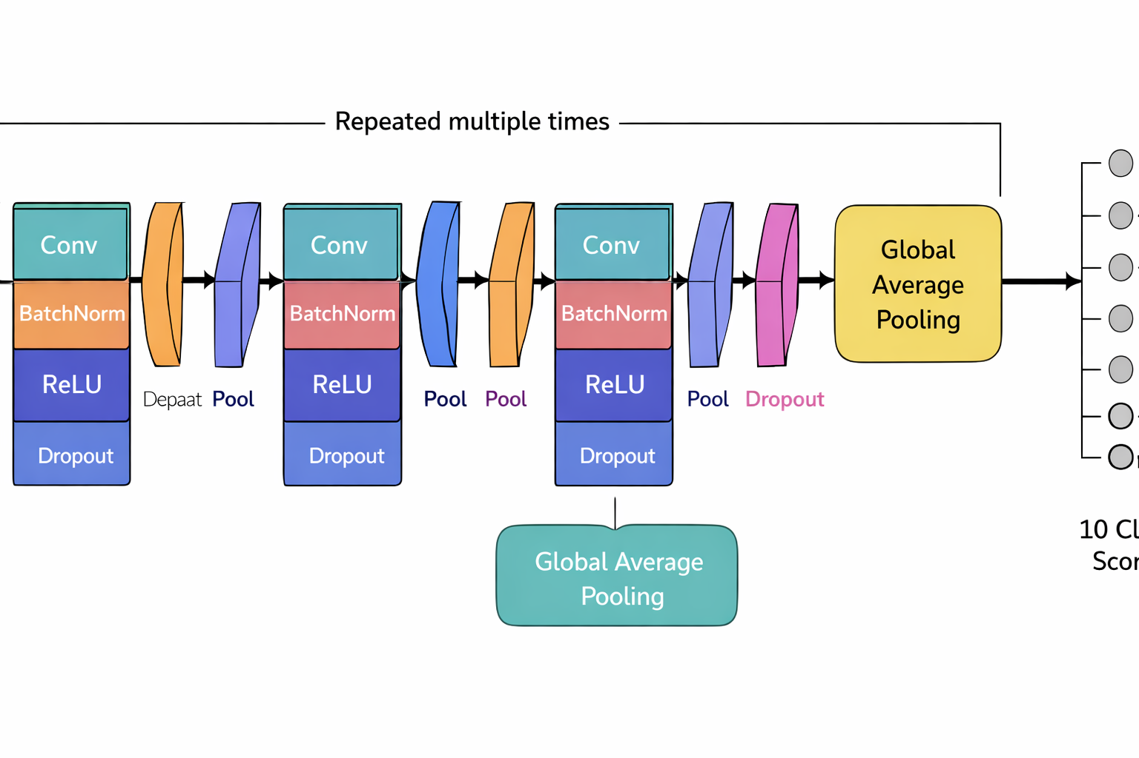
Model Architecture
CNN Architecture: Conv → BatchNorm → ReLU → Pool → Dropout Repeated multiple times Global Average Pooling Fully Connected Layer
10 classes

Slide 6
Training Setup
Training Setup:
Framework: PyTorch
Optimizer: AdamW
Learning rate: 0.003
Batch size: 64/128
Epochs: 25
Loss: CrossEntropy

Slide 7
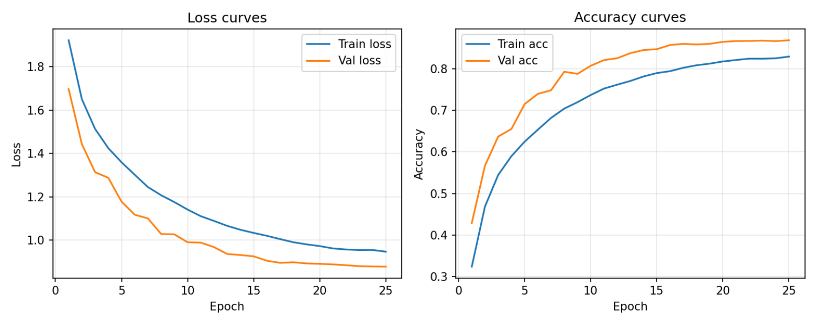
Results
Results:
Training accuracy: (0.8974)
Validation accuracy: (0.8686)
Test accuracy: (0.8588)
Loss & Accuracy curves

Slide 8
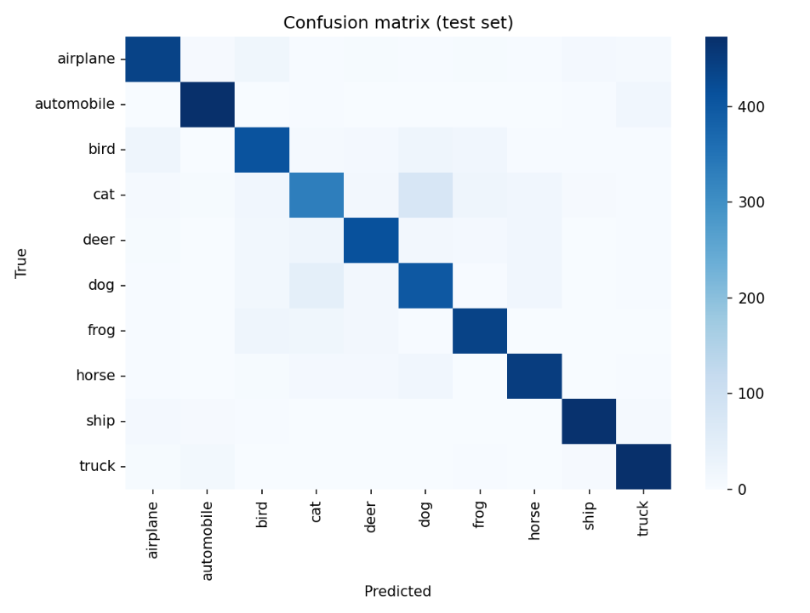
Evaluation Results
Evaluation Metrics:
Accuracy - shows the overall correctness
Precision - give deeper insight into classification performances
Recall - also give deeper insight into classification performances
F1-score - acts as the bridge that connects them, for a balanced performance

Slide 9
Analysis
Analysis:
Model learned general features
Some classes are confused (e.g., cat vs dog)
Possible issues: • Small image size • Similar classes • Limited training time

Slide 10
Conclusion
Conclusion:
CNN successfully learned image features
Performance depends on tuning and data quality
Deep learning is effective for image classification

